Slide 1
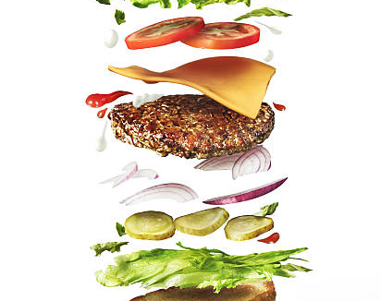
Web Project
(RMT Restaurants)
Make By:-
Ravi Raj Tiwari (GU-2023-1304)
Manisha Kumari (GU-2023-1267)
Tannu Kumari (GU-2023-1330)
Submitted to:-
Er. Pooja

Slide 2
Introduction & features on RMT Restaurants
RMT Restaurants is a prominent online food delivery and restaurant discovery platform.
The platform serves as a comprehensive guide, connecting users to a wide variety of dining establishments.
A user-friendly interface, omato facilitates easy exploration of local restaurants and their offerings.
Real-time order tracking is a key feature, allowing users to monitor their deliveries from placement to arrival.
RMT Restaurants partnerships with local restaurants contribute to its vast and diverse range of dining options, supporting local businesses.
RMT Restaurants offers comprehensive restaurant information, including menus, reviews, and ratings, empowering users to make informed dining decisions.
RMT Restaurants offers exclusive deals and discounts, providing users with cost-effective and rewarding dining experiences.
RMT Restaurants tagline – “Best Food gives a good health”

Slide 3

Why RMT Restaurants ?
Well, I have created my project thinking that nowadays everyone wants good food and hot food quickly.
In today's fast-paced world, our food ordering website reigns supreme: This line sets the stage by emphasizing the relevance and dominance of the food ordering website in contemporary times. It highlights the website's significance amid the hustle and bustle of modern life.
Services provide: We are trying to providing best services to another websites and restaurants.
Best food & healthy : we are offer only best and Hygiene foods are providing on costumers.

Slide 4
Contributors
Ravi Raj Tiwari
(Developer)
(Database Admin)
Manisha Kumari
(Project Manager)
(Content Writer)
Tannu Kumari
(UI Designer)
(QA Tester)

Slide 5

Roles
Ravi Raj Tiwari
Keeping the data security, data optimization and data integrity in check.
Maintaining the database.
Designing the database structure, schema and relationships based on the project’s requirement.
DBA(Database Administrator) :-
Testing and debugging the code.
Integrating the frontend with a backend.
Writing code for the web application and implementing the features and functionalities specified in the web project.
Developer:-

Slide 6

Roles
Ensuring the accuracy and the relevance of the information written in the content.
Understanding the target audience to meet their need, preferences, and interests.
Producing the written materials like articles, blogs, or other textual content.
Content Writer
Interacting with the client to make sure that the project meets the quality standards and requirements of the client.
Checking the coordination among the team members to ensure that everyone is aligned with the project goals and deadline.
Creating a comprehensive project plan, outlining the tasks, timeline, and resources requirement.
Project Manager
Manisha Kumari

Slide 7
Roles
Tannu Kumari
UI(User Interface) Designer
Creating the layouts, color schemas, and typography to ensure a good user interface.
Ensuring the web application to be responsive and interactive.
Getting feedbacks from the users to improve the design for a better user experience.
Testing the automation of the web application and its performance under high users load.
Identifying the defects and potential issues in the software.
Creating various test cases based on the project requirements to verify the functionality and performance of the web application.
QA(Quality Assurance) Tester

Slide 8
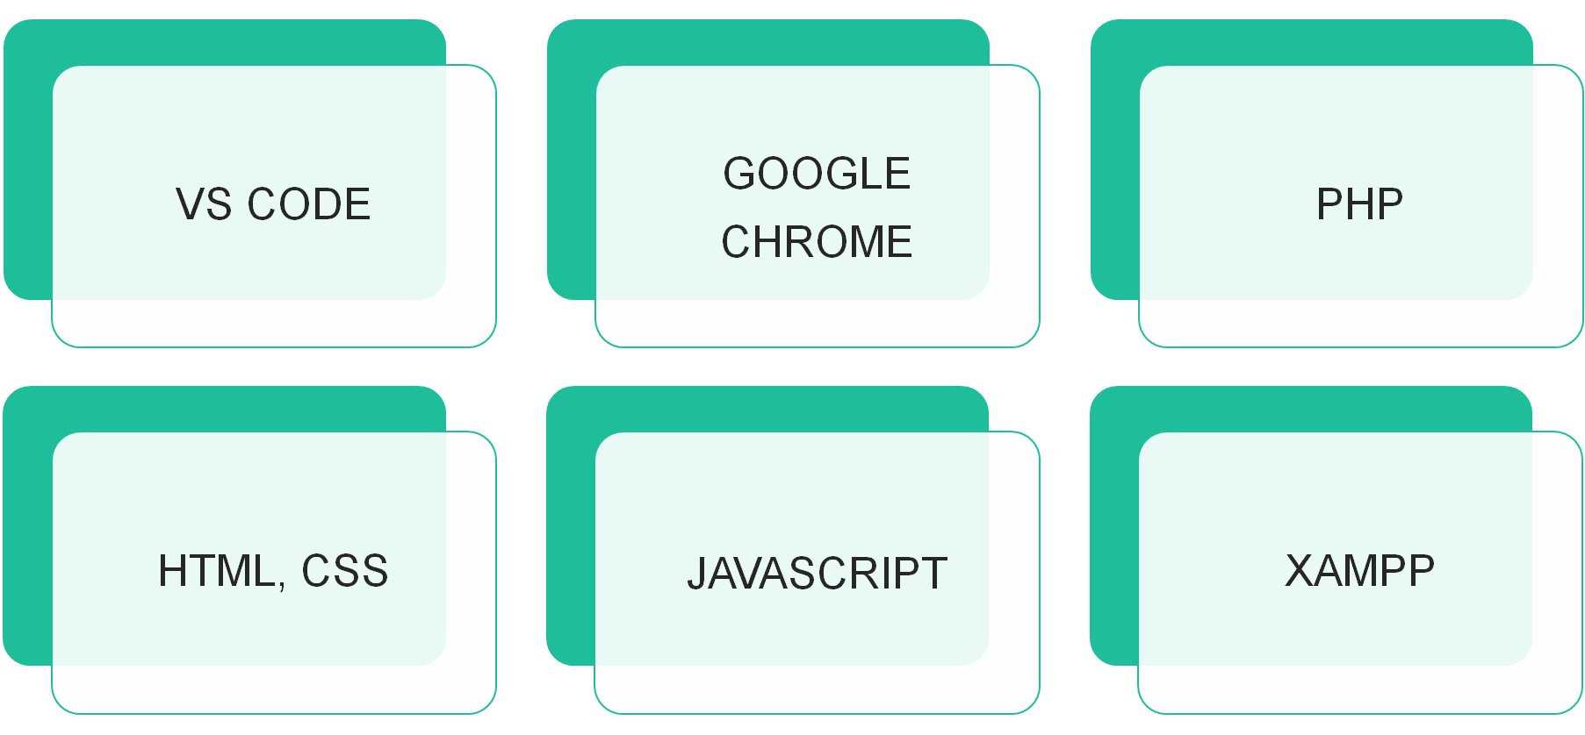
Using Software and Technologies

Slide 9

Section 1
Working Status

Slide 10

Project Progress-1
Firstly we create a login page and signup page
Second step was writing the code of the webpage.
Third was adding styles to it.
Fourth was filling the right content to the webpage.

Slide 11
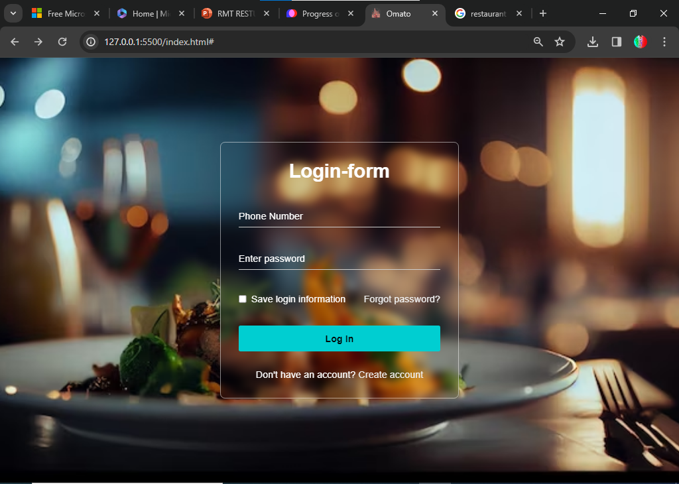
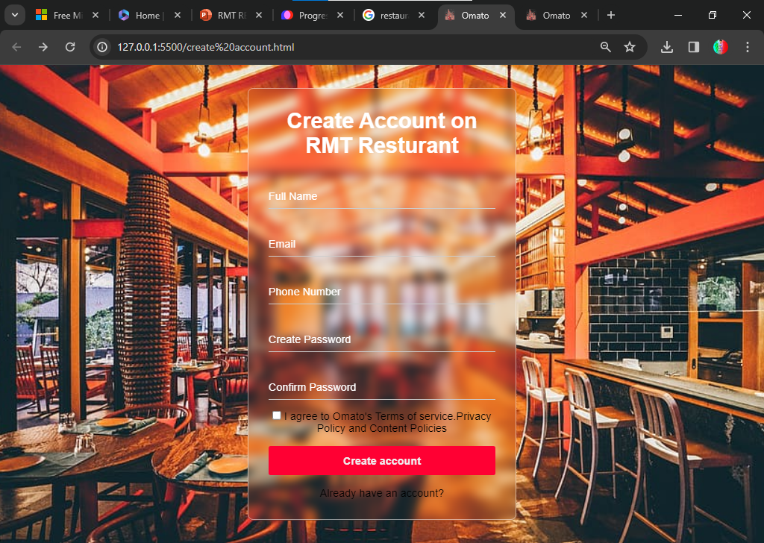
User login and signup page

Slide 12
Section 2
Building the Admin & customer Panel
Template on Canva

Slide 13
Project Progress-2
We Are Make a Template On Web Page How To View
Create a First Template On Admin & Costumer Panel How To Work
And Second O Write a content On Box Of Template

Slide 15
Section 3
Building the Admin Panel

Slide 16
Designing the User Interface
01
02
03
Layout and Navigation
The admin panel's user interface will feature an intuitive layout with easy navigation, ensuring that administrators can efficiently access and manage various functionalities.
Data Visualization
Incorporating data visualization elements such as charts and graphs to provide administrators with a clear overview of key metrics and performance indicators.
Responsive Design
Ensuring that the admin panel is responsive, allowing seamless access from different devices, including desktops, tablets, and mobile phones.

Slide 17

Implementing User Authentication
Secure Login
Utilizing robust authentication mechanisms to ensure that only authorized personnel can access the admin panel, safeguarding sensitive data and system controls.
Role-Based Access Control
Implementing role-based access control to define and manage permissions for different administrative roles, enhancing security and data integrity.
Password Management
Integrating features for password management, including options for reset, recovery, and enforcing strong password policies.

Slide 18
Section 3
Building the Customer Panel

Slide 19

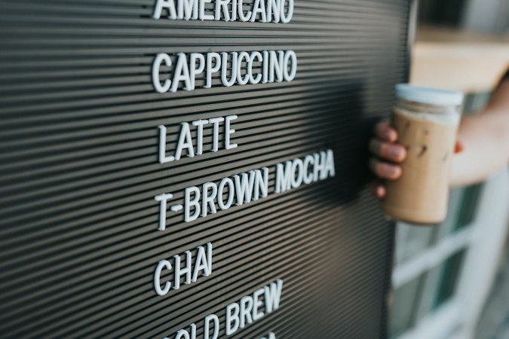

User-Friendly Ordering Interface
Menu Display
Creating an interactive and visually appealing menu display that enables customers to browse and select food items with ease.
Customization Options
Providing customization features for food orders, including options for dietary preferences, portion sizes, and additional ingredients.
Order Tracking
Integrating order tracking functionalities to keep customers informed about the status of their orders, from preparation to delivery.

Slide 20

Thank You
Have a nice day.

